Slide 1
Smart Learning Whole Class Sequence:
Feathers and Fools by Mem Fox
For Grade 5-8
Sequence written by: Patricia Pain

Slide 2
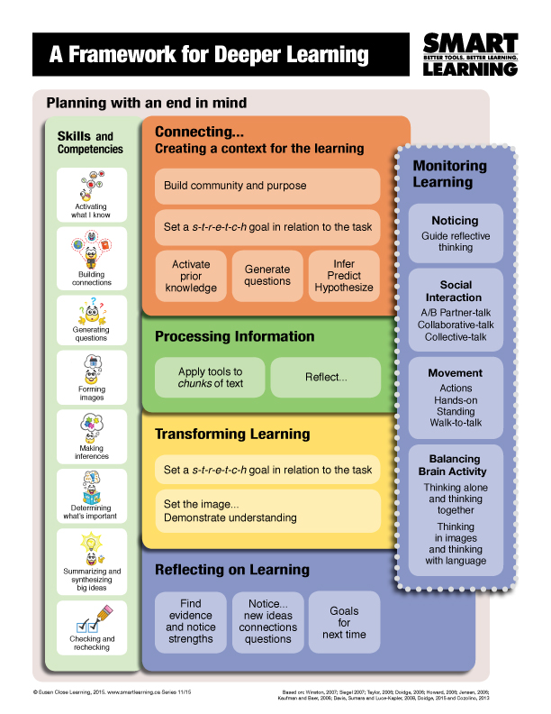
Lesson 1 – Connecting
1. Review Criteria for Respectful Listening and Powerful Speaking
2. Students determine AB partners
3. Set Oral Language Goal for today
4. Image a Time
PROCESSING
5. Weaving with Clues
6. Questioning
TRANSFORMING
7. Prediction Write
REFLECTING
8/9. New ideas, Questions, Connections, Noticing

Slide 3
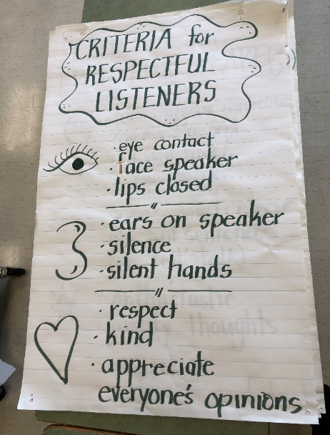
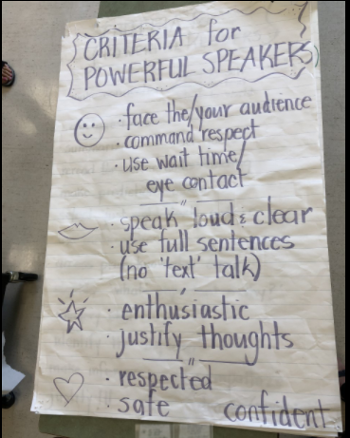
1. Review: Respectful Listening & Powerful Speaking
Let’s remind ourselves of the criteria we have been working on to be respectful listeners and powerful speakers.
What do we know about listening respectfully?
What do we know about speaking powerfully?

Slide 4
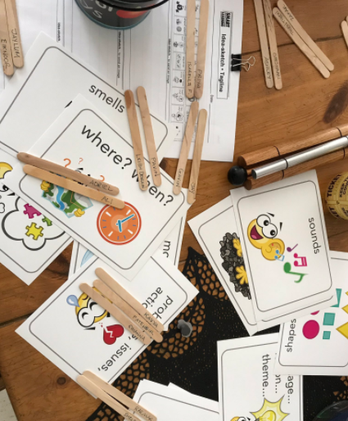
2. Students determine A/B Partners
We are going to do some important thinking today. I would like you to use a thinking-way to decide who will be A and who will be B. Your thinking way needs to be connected to:
Living in Fear
Even though your task is to determine who will be A and who will be B, this is actually your first clue to the story!

Slide 5
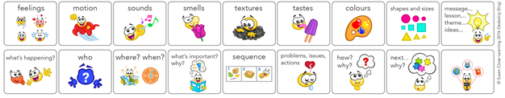
3. Set oral language goal for lesson 1
We are going to set an oral language goal for today
Today we will be noticing what makes powerful justifying
Every time someone uses the word, ‘because...’ we will be listening to notice what kind of evidence works to support or justify thinking
My goal for today is to justify my ideas with evidence from the clues I am given and any connections I may have.

Slide 6
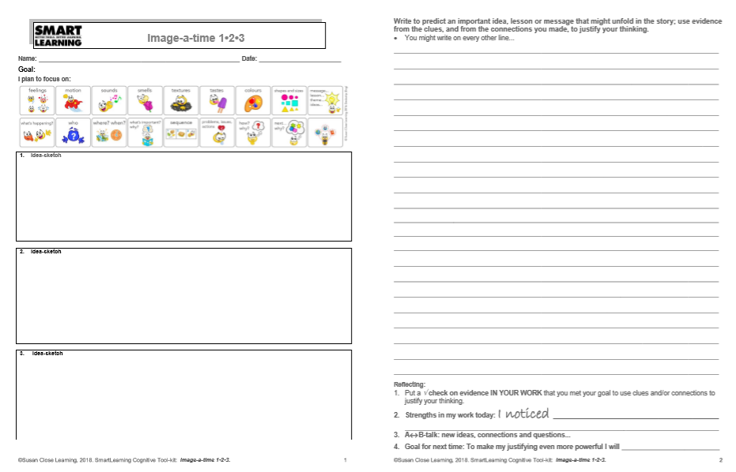
4. Activating Prior
Knowledge with
Image a Time 1-2-3
We are going to activate our prior knowledge by making some connections to clues
I want you to think of a time when you felt paranoid or nervous
Draw your image of this and if you’d like, you can add words as well
Now let’s think of a time when you witnessed someone planning or plotting to do something wrong
Draw your image of this and add words if you like
Now think of a time when you helped someone to feel accepted OR when someone helped you to feel accepted
Let’s meet with our partners to share our ideas and then we will report out

Slide 7
5. Predicting: co-creating criteria
Criteria | Evidence
Before we begin to make predictions, we need to brainstorm what makes a prediction powerful
What kinds of things do powerful predictors include in their predictions?
Let’s use this t-chart to record our ideas
You will be able to use this chart when you write your predictions today
You have 2 minutes to talk to your partner about what makes a powerful predictions
When you’re ready, we will co-create the list together

Slide 8
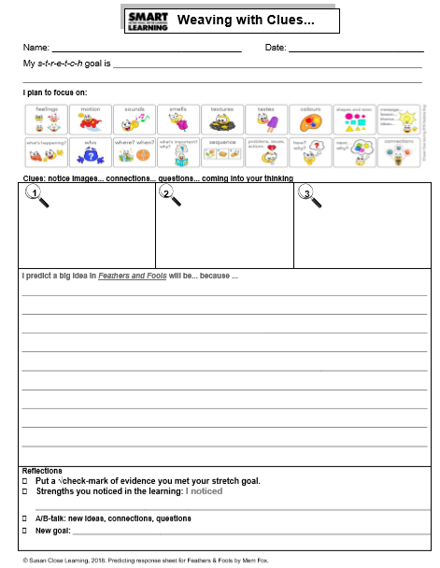
Predicting with: Weaving with clues
It’s time for us to receive more clues about our story
I will share 3 clues, one at a time
I will share the first clue now, look closely at it
Think about all the clues we have so far from Image a Time
When you are ready, talk to your partner about what you think the story might be about…as you talk, remember to include the criteria we brainstormed for making a powerful prediction
Now it’s time to write your prediction together then you will report out
Let’s report out now and then move onto the next clue
As you receive each new clue, you will notice that your predictions get more sophisticated because you have more to work with…you can even change your mind as long as you justify why you predict that!

Slide 9

6. Questioning before reading
Now that you’ve made some predictions about your story, I’m going to reveal one more clue
Take a look at the image, this is the cover of the book and the title of the story is: Feathers and Fools
Think about all the clues you have so far:
  Living in Fear
  Feeling paranoid or anxious
  Planning or plotting to do something wrong
  Feeling accepted
  And now…the cover of the book

Slide 10
6. Questioning before reading continued.
What are you wondering about the story?
What are you curious about?
What would you like to ask the author?
Take 2 minutes to talk to your partner then I will ask volunteers to share your question using the popcorn method
Now that it is time to share, we will use the popcorn method
  This means that if someone asks a question that sparks a question for you, pop up like popcorn with two hands up so I know you are adding to someone’s question and I will let you know when you can add your question
  If you have a brand new question, just pop up like popcorn and I will let you know when you can ask your question

Slide 11
7. End of lesson 1 Final Task
It’s now time to use everything we’ve done today to help us create a prediction
You have already started predicting today when we did Weaving with Clues, but now you will take it to writing
In a moment, you will stand up and talk with your partner one more time
Use the t-chart we created to help you with your prediction
Go ahead and discuss with your partner and when you’re ready you can co-create One powerful prediction
You will have 3-4 minutes to talk and when you’re ready you will begin writing your prediction
What do you predict will be the big idea/message in this story?

Slide 12

8. Reflecting on the Learning
It’s now time to reflect on the learning we did today…
What is something new you learned today that you did know before?
Are there any lingering questions or new connections you have made?
What is something you noticed about yourself as a learner today?
How did you do with your goal?

Slide 13
LESSONS 2, 3, & 4
Re-CONNECTING by:
  Activating Prior Knowledge
  Questions
  Reviewing Predictions
  Setting our s-t-r-e-t-c-h goal
PROCESSING with:
  5. Idea-Sketch-(Tagline)
TRANSFORMING with:
  6. Tagline
REFLECT
  7,8,9. New ideas, Questions, Connections, Noticing

Slide 14
1,2,3. Activating Prior Knowledge, Questions, Predictions
Before we begin ready our story today, we are going to re-connect with yesterday
Yesterday your final task was What do you predict will be the big idea/message in this story?
At the end of the day, I read all of your predictions and got very excited about your different ideas
I highlighted powerful phrases that met the criteria we co-created for powerful predictions
To help us re-connect to the story today, you and your partner are going to use your predictions and identify what I highlighted and why I highlighted it
You will record the evidence on the t-chart where it matches the criteria
When you are done, we will report out your evidence

Slide 15
1,2,3. Activating Prior Knowledge, Questions, Predictions cont’d….
Now that we have looked at our predictions and identified powerful criteria we have met, has anyone changed their mind of what might happen? Has your big idea changed? If so, what made you change your mind?

Slide 16
1,2,3. Activating Prior Knowledge, Questions, Predictions cont’d….
Before we set our reading s-t-r-e-t-c-h goal for today, let’s share any final questions you have about what you are about to read
What are you wondering?
What are you most curious about?
Why do you wonder this?

Slide 17
4. Setting our reading goal for lesson 2
We are going to set our s-t-r-e-t-c-h goal for reading today
Goal setting is a very important skill for readers to develop
Good readers do this automatically and to help them understand the story better
We will need to use our final task to help us set a goal – let’s look at how we do this

Slide 18
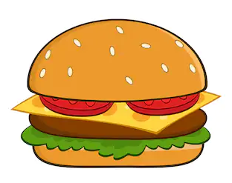
4. Setting our reading goal cont’d…
Setting our goal by using our final task is like a hamburger
The top bun is our final task and the bottom bun is our goal
Everything in the middle is the story
Let’s do a task analysis by looking at what the task is asking us to do…

Slide 19
4. Setting our reading goal cont’d…
This is your final task:
Write to show who you believe to be the fool in this story. Write in role as either a peacock or swan to show what you have learned from this terrible mistake and why you believe this foolish mistake happened.
Remember to justify your thinking and feeling in order to show the lesson you have learned.
What is our final task asking us to do?
Take 2 minutes to talk to your partner before we identify the criteria together as a class

Slide 20
4. Setting our reading goal cont’d…
Let’s work together to circle the criteria…I will highlight it on the task:
Write to show who you believe to be the fool in this story. Write in role as either a peacock or swan to show what you have learned from this terrible mistake and why you believe this foolish mistake happened.
Remember to justify your thinking and feeling in order to show the lesson you have learned.
Now let’s look at our icon strip and match the criteria to the icons we will focus on while we read

Slide 21
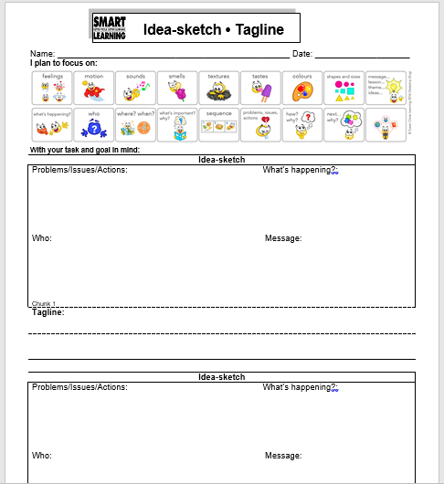
5. Processing with Idea-Sketch-Tagline
Now that we have set our goal, we are ready to read and process the story
To help us gather our ideas, we are going to use a tool called ‘Idea-Sketch-Tagline’
I will read the first chunk of the story, while you follow along
Then I will read the chunk for a second time while you begin thinking about and drawing/writing the important ideas and images from the text
I will read it a third time to give you more time to gather any ideas you may have missed
Then I will read it a fourth time, but you will radio read with me

Slide 22
5. Processing with Idea-Sketch-Tagline cont’d…
Remember that what we are capturing for this chunk are the icons we set out to focus on in our goal
I have written them into the tool sheet for you
When you’re ready, I will begin reading chunk 1
We will not be doing a tagline just yet, so just leave it blank for now
Let’s begin!

Slide 23
5. Processing with Idea-Sketch-Tagline cont’d…
Now that we have read the story together and you have gathered what you are focusing on for your goal, we are going to meet with our partners to discuss and share our ideas
Once you have shared your ideas, you will then decide on and rehearse a tagline to help us TRANSFORM our understanding of chunk 1
Please wait for those instructions, you may begin sharing your ideas with your partner!

Slide 24
6. Transforming with Tagline
Now that we have read the story together and shared our ideas with our partner, we are going to create a tagline to help us synthesize what we learned from chunk 1
Now, look at your pictures and ideas you captured and think about what is really important in the passage/s I read
With your partner, I want you to think of some words – 5 to 7 – that will capture what’s important in your picture
We call this a putting a tagline on a picture.
Your words need to send a clear image and a feeling of what is important
Think of it like a newspaper headline
If I had read you a news story about flooding, my picture might be about people leaving. A tagline might be: Floodwaters rising people race to leave. Do you get a picture from those words? Do you get a feeling? Look at your picture. Come up with 5-7 words that send an image and a feeling.

Slide 25
6. Transforming with Tagline cont’d…
You will have 5 minutes to generate a tagline to share
You will need to work together to help each other with this
Once you are done, write it down on your tool sheets
After your partner talk time, I will give you the sentence prompt for reporting out
You may begin!

Slide 26
6. Transforming with Tagline cont’d…
Here is your sentence prompt:
“The tagline my partner, _________, and I decided on is ____________. We feel this is important because_____________________. Right now we believe the fool in the story is ______________ because ________________.”
You will have 2 minutes to rehearse and then we will report out to the class

Slide 27
7,8,9. Reflecting on the Learning
It’s now time to reflect on the learning we did today…
What is something new you learned today that you did know before?
Are there any lingering questions or new connections you have made?
What is something you noticed about yourself as a learner today?
How did you do with your goal?

Slide 28
Lessons 3 & 4
Repeat slides 14 – 27 for these lessons
Students will follow the same format for chunks 2 and 3

Slide 29
Connecting for lessons 3 & 4
Yesterday you did a lot of smart thinking on the story, Feathers and Fools
Before we move into chunk 2, we are going to re-connect with where we left off so that we can get our brains warmed up
To help us remember and jump back into the story, you are going to re-read everything you and your partner captured yesterday
Look at the images you captured, read your words, read your tagline
Look at your Idea-Sketch-Tagline from yesterday
I invite you to use a different colour pen to record any new questions, connections, or predictions since yesterday
Go ahead and begin re-connecting now

Slide 30

Connecting for lessons 3 & 4 cont’d…
I would like to invite you now to share any new ideas, questions, connections, or predictions that came to mind as you re-connected with chunk 1
We will use the popcorn method to share

Slide 31
LESSON 5
Re-CONNECTING by:
  Activating Prior Knowledge
  Questions
  Reviewing Predictions
  Reviewing reading goal
PROCESSING with:
  5. Task Analysis
TRANSFORMING with:
  6. Final Task
REFLECT
  7,8,9. New ideas, Questions, Connections, Noticing

Slide 32
1, 2, 3. Activating Prior Knowledge, Questions, Predictions
Over the last few days you did a lot of smart thinking on the story, Feathers and Fools
You have been gathering all that you need to help you respond to the final task where you will write in role as either a peacock or swan
You will also need to explain who you believe to be the fool and why this terrible mistake happened
Before we move into our final task, we are going to re-connect with the story.
Look at the images you captured, read your words, read your taglines. As you read, you might find that new ideas, questions, or connections come to mind, review your goal and what you set out to gather as you read
Feel free to use your different colour pen to add it to chunk 1, 2, 3
Go ahead and begin re-connecting now, we will share when you are done

Slide 33
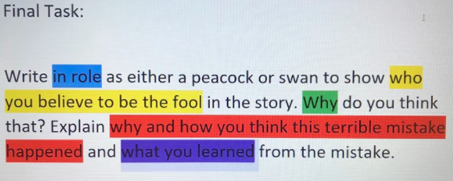
4. Processing with task analysis
It is almost time to transform and demonstrate your understanding of the story
Before moving into the writing portion we will need to do a task analysis and set the image
Let’s review our final task again:
Write to show who you believe to be the fool in this story. Write in role as either a peacock or swan to show what you have learned from this terrible mistake and why you believe this foolish mistake happened.
Remember to justify your thinking and feeling in order to show the lesson you have learned.

Slide 34
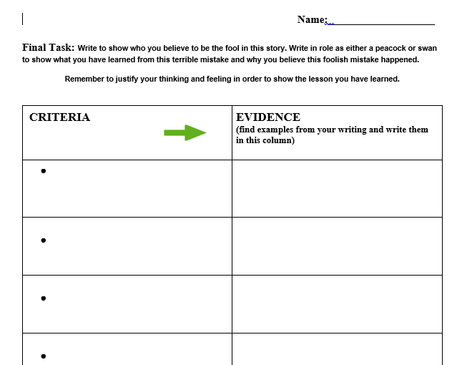
4. Processing with task analysis & Set the image cont’d…
It’s time to shift our focus to writing now
Together, we are going to co-create the criteria for powerful writing
You can copy this down in your t-chart

Slide 35
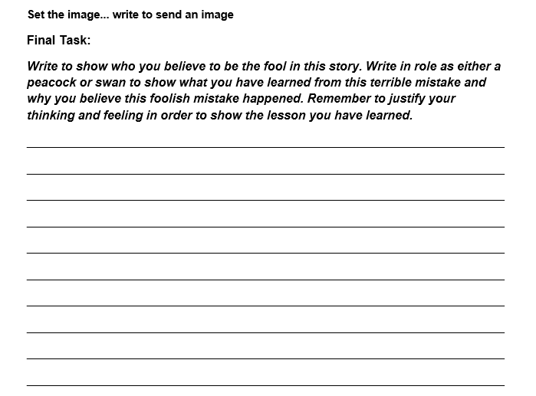
5. Transforming with the final task & Set the Image
You are about to begin your response to your final task
Now, you are about to write in role as either a peacock or a swan
See yourself as _________. What are you thinking?
What are you feeling? What is causing you to feel this way? What happened?
Notice where you are in the story. Notice the smells around you. Notice the emotions
Notice the sounds. Notice the voices. Take me into your life as _________ and show me who you believe to be the fool in this story and why.
Remember that you have been gathering everything that you need for this write
Don’t forget that you can look back at what you gathered in your chunks to help you
You may begin

Slide 36
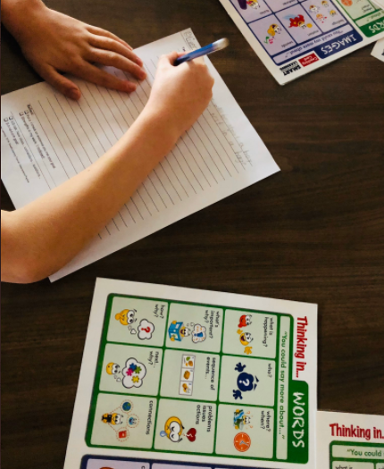
5. Transforming with the final task & Set the Image cont’d…
As I move about I am going to tap you on the shoulder and invite you to read your beginning
Hearing ideas is like a fuel pump for thinking
As you are writing feel free to cross out words and add new words
If you don’t like your beginning, put an X and start again
Writers start, stop and then start again
Each time they get closer to what they really want to say
Once you are done your writing, I will collect them
Overnight I will highlight powerful phrases

Slide 37
8. Reflecting on the Learning
It’s now time to reflect on the learning we did today…
What is something new you learned today that you did know before?
Are there any lingering questions or new connections you have made?
What is something you noticed about yourself as a learner today?
How did you do with your goal?

Slide 38
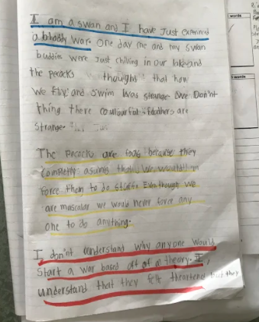
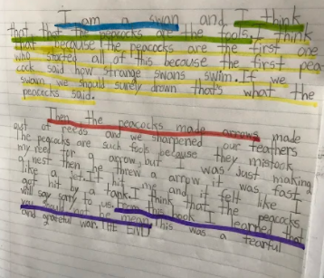
LESSON 6 – POLISHING OUR WRITING
Today is about polishing our writing!
I am going to hand back your writing and I invite you and your partner to talk about why you think I highlighted your writing
What criteria did you meet?
As you look through your writing,
record evidence that matches the criteria in the T-chart.
You can use this time to polish
and rewrite your final task
once more before submitting
for a final assessment

Slide 39
Thank you for your hard work! I hope the message in the story is something you can carry with you everyday. Go out there are be the leader you are!

